Slide 1
Azure Data PipLine
Ajinkya A W

Slide 2

Agenda
Project Overview
Data Processing
Key Metrics & Results

Slide 3
Project Overview

Slide 4
Project Objective
Business Problem:
Data Ingestion and Management: The organization faced challenges with efficiently ingesting, transforming, and managing large datasets from multiple sources, including customer, transaction, and branch data.
Real-Time Data Processing: The need for real-time data processing to enable timely insights and decision-making was critical but not effectively addressed by existing systems.
Data Quality and Consistency: Ensuring data quality, consistency, and accuracy across different stages of processing was essential but challenging due to the complexity of data sources and formats.
Fraud Detection Capabilities: The existing system lacked the capability to effectively identify and flag potential fraudulent activities in real-time, putting the organization at risk.
Customer Segmentation: The organization struggled with accurately segmenting customers based on their transaction behaviors and other attributes, hindering targeted marketing efforts and personalized customer experiences.
Project Goals:
Implement a Robust Data Pipeline: Develop a scalable data pipeline architecture using Azure Databricks to handle both batch and streaming data efficiently.
Optimize Data Transformations: Use the Medallion architecture (Bronze, Silver, Gold layers) to clean, transform, and aggregate data, ensuring high data quality and readiness for analytics.
Enable Real-Time Analytics: Provide real-time data processing capabilities to support live dashboards and immediate insights into business metrics.
Facilitate Data-Driven Decision Making: Provide enriched, high-quality data to downstream analytics tools like Power BI to support strategic and operational decision-making.
Enhance Customer Segmentation: Improve customer segmentation by processing and analyzing enriched data to create more targeted and effective marketing strategies.

Slide 5
Key Outcomes
Improved Data Accessibility:
All relevant data is made accessible in a consistent, reliable format, enabling more informed business decisions.
Optimized Reporting: Faster and more accurate reporting that enables stakeholders to make data-driven decisions with confidence.
Enhanced Data Quality:
Data cleaning and transformation processes reduce errors and inconsistencies, leading to more accurate analysis and reporting.
Scalability and Flexibility:
The data pipeline is scalable, able to handle increasing data volumes, and flexible enough to integrate new data sources as needed.
Advanced Fraud Detection: Enhanced capabilities to identify and mitigate fraudulent activities in real-time, reducing potential risks to the organization.
Improved Customer Segmentation: More accurate and effective customer segmentation, leading to increased customer satisfaction and optimized marketing efforts.

Slide 6
High-Level Description of the Data Pipeline
The project involves designing and implementing a robust data pipeline using Azure Databricks to handle both batch and streaming data. The pipeline follows the Medallion architecture, which organizes data into Bronze, Silver, and Gold layers to ensure data quality, consistency, and readiness for analytics.
The pipeline incorporates real-time fraud detection, customer segmentation, and advanced data processing capabilities, enabling the organization to gain actionable insights and optimize its business operations.
Data Sources:
Customer Data: Ingested from various systems and stored in the landing zone as raw data.
Transaction Data: Streamed in real-time, capturing every transaction with attributes such as transaction ID, customer ID, branch ID, amount, channel, type, and timestamp.
Branch Data: Static data detailing branch locations, names, and associated time zones.

Slide 7
Data Processing

Slide 8
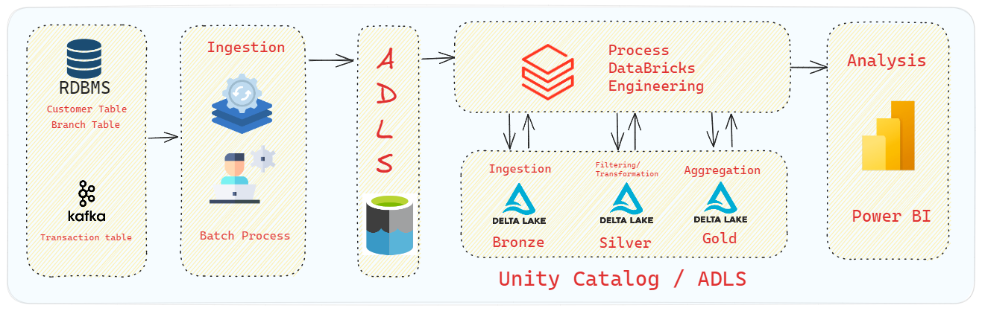
Architecture & Data Flow

Slide 9
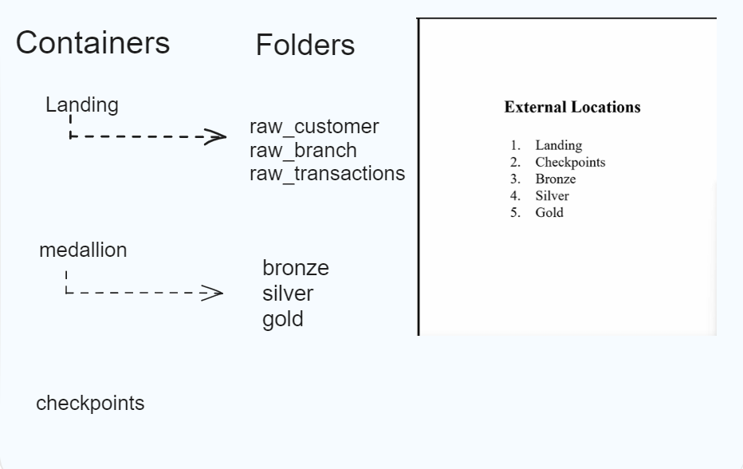
ADLS Structure
I organized Azure Data Lake Storage (ADLS) into a structured directory system to efficiently manage and process data:
Landing Zone:
raw_customers/: Repository for raw customer data.
raw_transactions/: Repository for raw transaction data.
raw_branches/: Repository for raw branch data.
Checkpoints: A dedicated directory for storing checkpoints to support data streaming and processing continuity.
Medallion Architecture:
Bronze/: I stored raw, unprocessed data directly ingested from the landing zone, maintaining data in its original form.
Silver/: I transformed and cleaned the raw data from the Bronze layer, preparing it for further enrichment and analysis.
Gold/: I aggregated and prepared the data in the Gold layer, making it analytics-ready and suitable for business intelligence and reporting.
A dedicated directory for storing checkpoints to support data streaming and processing continuity.

Slide 10
Architecture & Data Flow During the data pipeline implementation, streaming data and static data sources required distinct strategies
Transactions Table (Streaming Data):
Trigger Used: continuous
Reasoning: I implemented the Continuous trigger for the transactions table to ensure that data processing happens in real-time. This approach was essential to meet the project's requirement of continuously monitoring and detecting fraudulent activities as they occur. The Continuous trigger allowed me to process incoming transactions data instantly, enabling immediate insight generation and timely response to any detected anomalies.
Customers and Branches Tables (Static Data):
Trigger Used: Once
Reasoning: I utilized the Once trigger for processing the static data in the customers and branches tables. By applying the Once trigger, I ensured that the data in these static tables was processed in a single execution. This was appropriate for the nature of the data, which does not change frequently, allowing me to efficiently synchronize it with the continuously updated transactions data. This approach enabled me to keep all datasets aligned and up-to-date with minimal processing overhead.

Slide 11
Bronze Layer (Raw Data)
Ingested raw customer, transaction, and branch data into the ADLS landing zone.
Used Azure Databricks to store this raw data in the Bronze layer without transformations, ensuring an immutable, auditable record.
I implemented explicit schema definitions in both the Bronze and Silver layers to ensure data consistency and quality.

Slide 12
Schema Design & Management
Schema Evolution: I designed and managed the schema for the project to ensure the seamless integration of both static and streaming data. The schema was structured to accommodate evolving data requirements, allowing for the addition of new fields and modifications without disrupting existing data processes.
Bronze, Silver, and Gold Layers: The schema was adapted across the Medallion architecture:
Bronze Layer: The schema captured raw data in its original form from the landing zone, including all fields from the source systems.
Silver Layer: The schema was refined to clean, transform, and enrich the data, creating a more structured dataset that includes newly derived columns such as city, state, and zipcode extracted from address fields.
Gold Layer: The final schema in this layer was optimized for analytics, focusing on aggregated data, customer segmentation, and fraud detection, ensuring it was ready for business intelligence and reporting.
Handling of Schema Evolution: I implemented schema evolution features to ensure that changes in the data structure were automatically accommodated without requiring manual intervention, thus maintaining the integrity of the data pipeline.

Slide 13
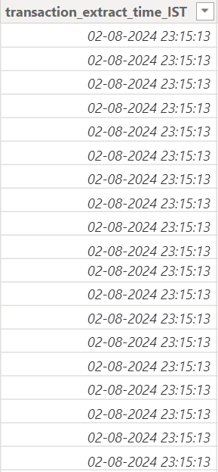
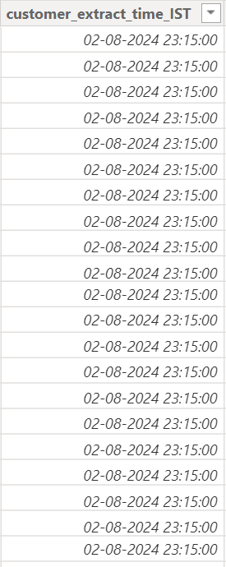
Silver Layer (Cleaned)
Cleaned and enriched the raw data from the Bronze layer.
Performed necessary transformations such as regex-based formatting, timestamp conversions, and extracting additional features like customer segmentation categories.
Store the processed data in the Silver layer, ready for further aggregation and analysis.
Extract Time UTC to IST Conversion:
During the data transformation process, I implemented a step to add a new column, extract_time_UTC, to each dataset.
This column captured the exact timestamp of data extraction in Coordinated Universal Time (UTC).
Subsequently, the extract_time_UTC was converted to Indian Standard Time (IST) to create an additional column, extract_time_IST.
This conversion was essential to align the dataset with the local time zone, making it easier for analysis and reporting within the context of the business operations in the IST time zone.
The extract_time_IST column was particularly useful in the final Gold layer for ensuring that all timestamps were consistent and localized, providing accurate temporal context for insights derived from the data.

Slide 14

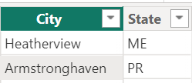
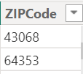
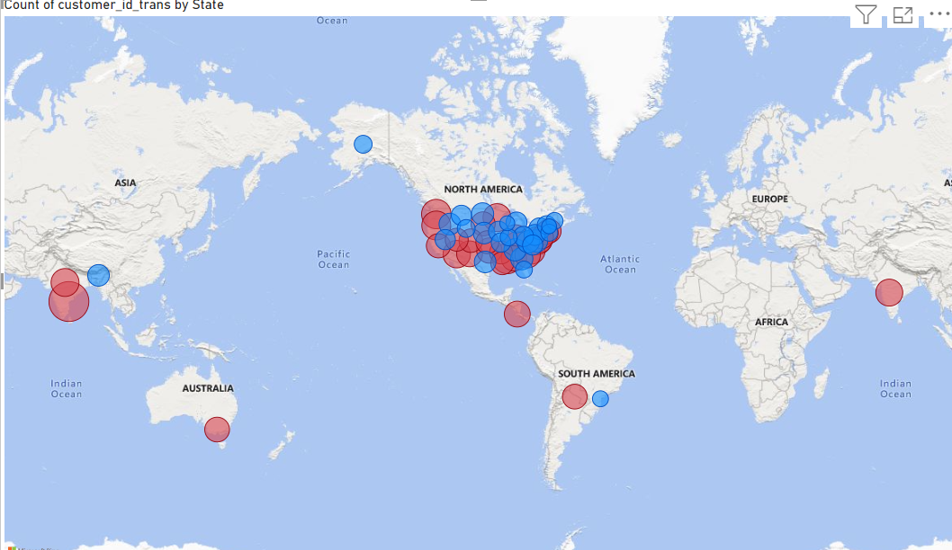
Silver Layer (Cleaned)
Address Parsing and Column Creation:
As part of the data transformation process, I extracted and parsed the full address data into separate columns: city, state, and zip code.
This involved processing the raw address information, which was initially stored as a single string, and programmatically splitting it into these distinct components.
The separation of address data into these specific columns improved data granularity and enabled more detailed analysis and reporting based on geographical factors.
These newly created columns were included in the Silver layer, enriching the dataset and providing more structured and accessible data for downstream analysis, particularly in customer segmentation and regional transaction insights.

Slide 15
Gold Layer (Aggregated Data for Analytics)
In the Gold layer, I performed aggregation and summarization of the data from the Silver layer.
This included generating key business metrics, such as transaction counts, total amounts, and customer segments.
I also implemented real-time fraud detection mechanisms, flagging suspicious activities based on predefined rules and patterns.
The Gold layer data was made analytics-ready, enabling it to serve as the foundation for reporting and dashboarding in Power BI.

Slide 16
Final Destination
The aggregated and processed data in the Gold layer was made accessible for business analytics and reporting through tools like Power BI.
I also ensured the data was saved in CSV format in Azure Data Lake Storage (ADLS) for archival purposes and potential external use.
The pipeline supported real-time monitoring and analysis,
particularly focused on detecting and flagging fraudulent transactions.

Slide 17
Key Metrics & Results

Slide 18
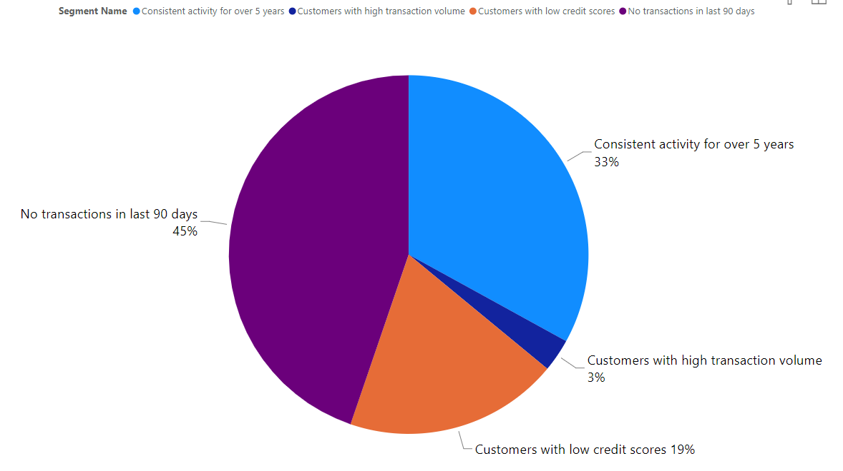
Customer Segmentation
Customer Segmentation Insights:
Largest Segment: The majority of customers (45%) fall into the "No transactions in last 90 days" category, indicating a significant portion of inactive customers.
Loyal Customers: 33% of the customers have "Consistent activity for over 5 years," showing a strong base of long-term, loyal customers.
Credit Risk: 19% of the customers are categorized as "Customers with low credit scores," highlighting potential risk areas for the business.
High-Value Customers: A smaller segment (3%) is identified as "Customers with high transaction volume," indicating high-value customers who are crucial for business revenue.

Slide 19
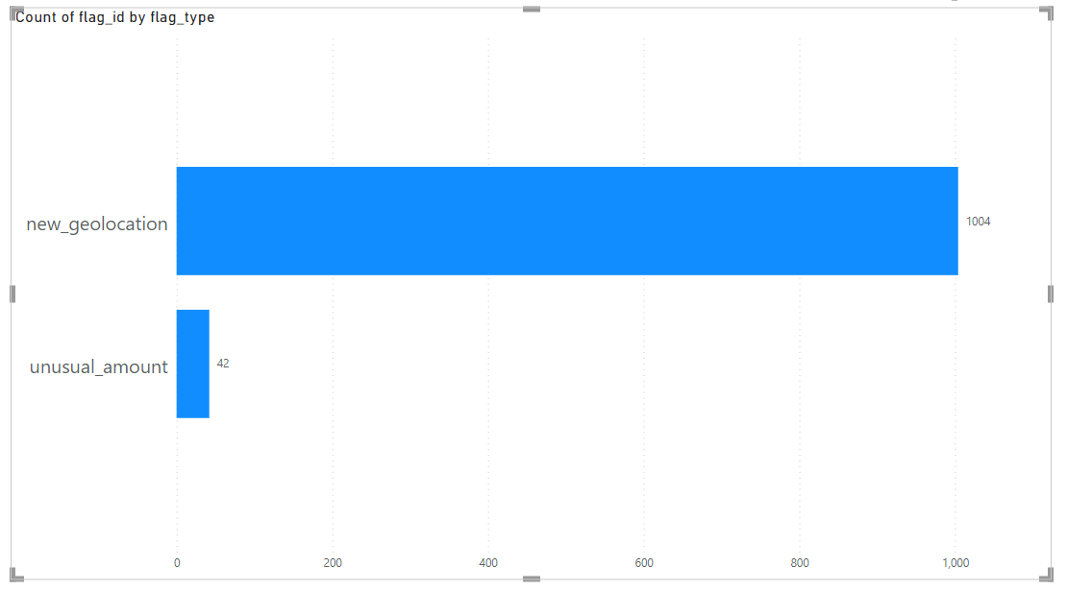
Fraud Detection
Fraud Detection Insights:
New Geolocation Flag: The majority of the flagged transactions (1004 instances) are due to the new geolocation flag. This indicates that a significant number of transactions are being conducted from locations that differ from the customer's usual geolocation, which could be a potential indicator of fraudulent activity.
Unusual Amount Flag: There are 42 transactions flagged under unusual amount, suggesting these transactions deviate significantly from the typical transaction amounts for the respective customers.
This flag helps in identifying potentially suspicious transactions that involve unusually large amounts.

Slide 20
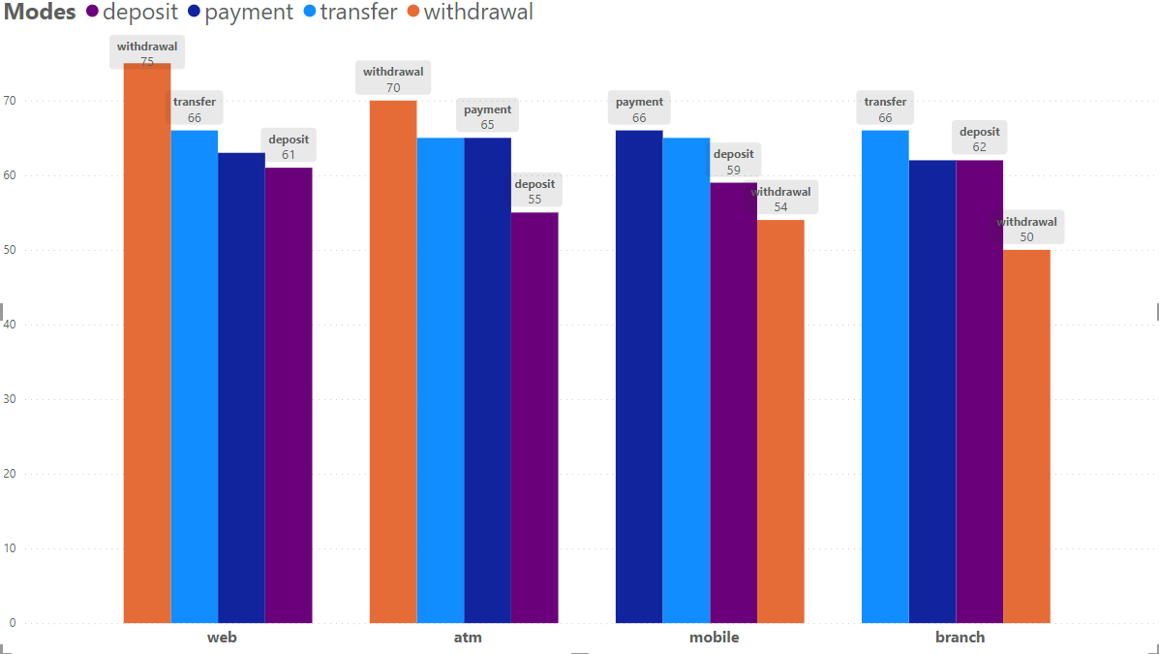
Transaction Distribution by Channel and Type

Slide 21
Transaction Distribution by Channel
Business Implications:
Channel Preferences: The data highlights customer preferences for different transaction types across various channels, providing insights into how customers interact with banking services.
Service Optimization: Understanding these patterns can help optimize service offerings and resources across channels. For example, enhancing mobile app functionalities for payments and transfers could increase customer satisfaction and usage.
Fraud Detection: Monitoring transaction patterns across channels can also aid
in identifying unusual activities and potential fraud. For instance, a sudden spike in withdrawal transactions through the web channel might warrant further investigation.
Web Channel:
The withdrawal transaction type has the highest count, indicating a preference for online withdrawals.
Transfer transactions are also significant, showing a notable usage of online transfers.
ATM Channel:
Similar to the web channel, withdrawal transactions dominate, reflecting the primary use of ATMs for cash withdrawals.
Payment transactions are significant, highlighting ATMs' role in bill payments and other financial transactions.
Mobile Channel:
Payment and transfer transactions are more prominent, showing the convenience and flexibility of mobile banking.
Withdrawal transactions are less frequent, indicating a lower use of mobile apps for cash withdrawals.
Branch Channel:
Transfer and deposit transactions are most frequent, suggesting branches are primarily used for transferring funds and depositing money.
The presence of withdrawal transactions indicates that branches are still used for cash withdrawals, though less frequently compared to ATMs and web channels.

Slide 22
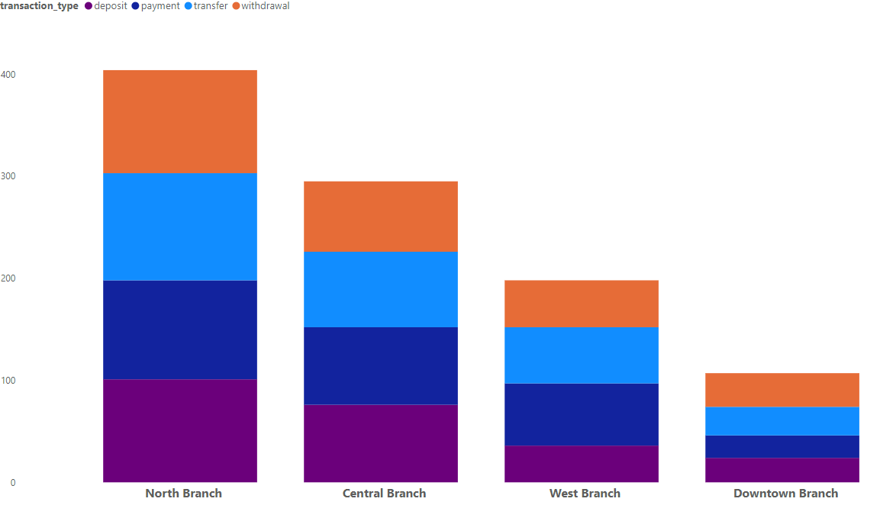
Transaction Distribution Across Branches
Business Implications:
Resource Allocation:
More resources might be needed at the North Branch to handle the high volume of transactions.
Downtown Branch may need marketing efforts to boost its transaction volume.

Slide 23
Global Transaction Distribution Across States

Slide 24
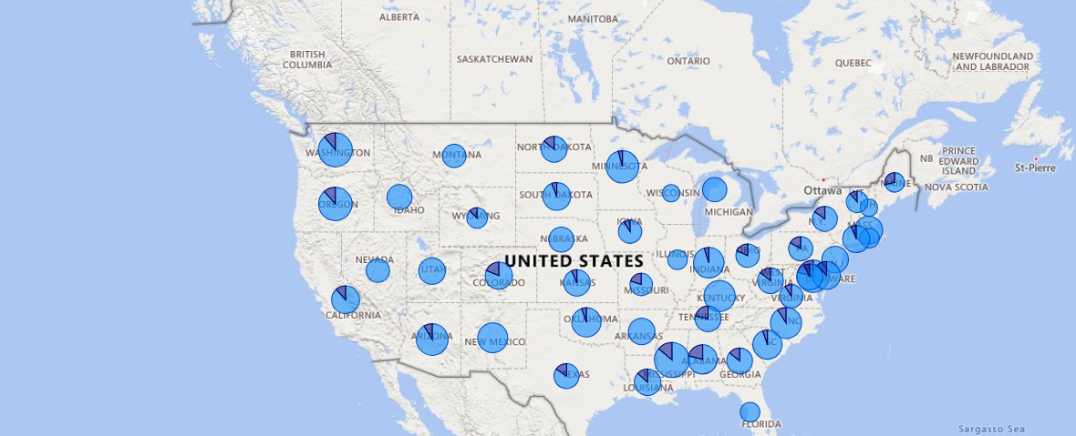
Transactions Insights State-Wise Pending and Completed
Operational Bottleneck Identification
Regional Performance Analysis

Slide 25
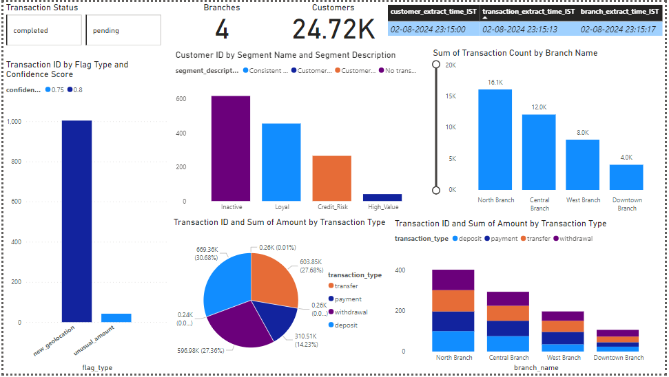
Dashboard

Slide 26




Thank you
Ajinkya A W
ajinkyaw@maveris-systems.com

